Slide 1

V2V Communication approach towards Autonomous Driving using Vanet and Telematics
By
1. Vaishnavi Bhoyar 2. Anant Sinha 3. Vishal Dixit
4.Ganesh Gawali 5.Santoshi Nawkhare
B.E. 7th Semester
Department of CSE-IT
Prof. Pranjali Ulhe Prof. Supriya Sawwashere Prof. Madhuri Pal
Project Guide Project Incharge H.O.D. IT-CSE
JD College Of Engineering & Management Nagpur
2019-20

Slide 2
Index
Introduction
Literature Survey
Problem Statement
Proposed Methodology
Advantages
Applications
References

Slide 3
Introduction
Wireless Communication leads to reduction in physical operation of machines.
WSNs combining with the latest upcoming technology Vanet and Telematics provides various advantages.
This feature is now going to be implemented in Indian Automobile Industry.
* Adhoc Network:-
- Type of computer to computer connection.
- Set up a wireless connection
- Used for sharing a files or document.
* Vanet :-
- Consists of “large web of vehicles” and “WLAN technology” which connects all the vehicles together to make communication possible.
- Several modes of vehicle communication →Vehicle to vehicle (V2V) , Vehicle to infrastructure (V2I) etc.
- The main aim of VANETs is to build an Intelligent Transport System (ITS).

Slide 4
Introduction
* V2V Communication :-
- Provides Data exchange platform.
- Vehicles can share information among themselves.
* Telematics :-
- Technology of sending, receiving and storing information using telecommunication devices to control remote objects.
- Data sent in a packaged format to a data center. The data then gets decoded.
* Autonomous Driving :-
- AI technologies power self-driving car systems.
- Vehicle that uses a combination of sensors, cameras, radar and artificial intelligence (AI) to travel between destinations without a human operator.

Slide 5
Literature Survey
Sr. No. | Paper’s Name | Publication | Publication Year | Author’s Name
1. | An Integrated Longitudinal and Lateral Vehicle Following Control System with Radar and Vehicle-to-Vehicle Communication | IEEE | 2018 | Shouyang Wei, Yuan Zou, Xudong Zhang, Tao Zhang, and Xiaoliang Li
2. | Utilization of modern sensors in autonomous vehicles | IEEE | 2018 | Michal Taraba, Juraj Adamec, Matus Danko, Peter Drgona
3. | Self Driving Cars: A Peep into the Future | IEEE | 2017 | T.Banerjee1, S.Bose2, A.Chakraborty3 , T.Samadder4
4. | Synthesizing Vehicle-to-Vehicle Communication Trace for VANET Research | IEEE | 2017 | Feng Lv1, Hongzi Zhu1, Shan Chang2, Mianxiong Dong3
5. | Secure Vehicle Location-Sharing for Trajectory-Based Message Delivery on VANETs | IEEE | 2017 | Youngho Park∗ , Chul Sur† , Si-Wan Noh‡ , and Kyung-Hyune Rhee ∗

Slide 6
Literature Survey
Sr. No. | Paper’s Name | Publication | Publication Year | Author’s Name
6. | Virtual Assistants and Self-Driving Cars:- To what extent is Artificial Intelligence needed in Next-Generation Autonomous Vehicles? | IEEE | 2017 | Giuseppe Lugano ERAdiate team,
7. | Data communication in VANETs: Protocols, applications and challenges | Elsevier | 2016 | Felipe Cunha , Leandro Villas , Azzedine Boukerche , Guilherme Maia
8. | Embedded Systems for Intelligent Vehicle Research A Case Study of Hardware-In-the-Loop Data bus Testing Techniques | ACM | 2016 | Alan M. Barker, Gary J. Capps, Mary Beth Lascurain
9. | Advanced Fuel Level Tracking System Using Telematic Unit | IEEE | 2015 | Dhivyasri G , Rajeswari Mariappan
10. | Autonomous Cars: Past, Present and Future :- A Review of the Developments in the Last Century, the Present Scenario and the Expected Future of Autonomous Vehicle Technology | ACM | 2014 | Keshav Bimbraw

Slide 7
Literature Survey
[1] suggests ,
Proposes an integrated longitudinal and lateral control framework in vehicle following scenarios with millimeter wave radar and V2V communication
Proposed Path Estimation Method to calculate the trajectory of the preceding vehicle based on its historical movement data transmitted by V2V.
The robustness and adaptability of the proposed method are validated by simulations and tests under several driving conditions.
[2] suggests ,
sensors used to locate the position in autonomous vehicle systems are mentioned
it is necessary to use more types of sensors in order to improve the autonomous system.
Subsequently, the principle of the operation of individual sensors was described, from which it can be concluded that no sensor provides sufficient information about the surroundings.
The advantage of a combination of sensors is that the disadvantage of one sensor can be improved by the advantage of the second sensor
[3] suggests,
unique embedded controller design of a driverless, green energy powered, collision protected and GSM destination guided vehicle.
The functionality of the entire system is divided into obstacle sensing, locomotion, traffic light detection, information to the user and the navigation of the vehicle.
The energy source is renewable and will not face problem due to scarcity of conventional fuel in future.
[4] suggests,
introduce the statistical analysis results on V2V communication performance, based on a large volume of real-world measurement trace collected in Shanghai city.
propose a novel scheme to synthesize V2V communication traces which can be of great value for VANET-related research, such as network protocol design and simulations.

Slide 8
Literature Survey
[5] suggests,
propose a secure location-sharing system to allow a vehicle to share its driving trajectory with roadside units authorized by the vehicle.
proposed system was designed by exploiting an id-based proxy re-encryption scheme with pseudonym management.
make the trajectory data are hidden from not only unauthorized entities but also the central manager by making use of proxy re-encryption schemes.
[6] suggests,

Slide 9
Problem Statement
According to the research from 2012-2018, it has been found that a lot of research has been carried out in the field of Vanet and Telematics separately.
But the most of the research has not been implemented yet in the real world.
Moreover, it has also been concluded from the research that the Vanet and Telematics together has never been used yet.
The upcoming technology with Vanet and Telematics together can make a great future in Indian automobile Industry.

Slide 10
Drawbacks
The current output information obtained from the TeCU has to be given to server using GSM/GPRS module. Then a webpage has to be created according to fetch the live information from the vehicle and to be monitored.
The virtual assistants for some vehicles like Toyota, Wolkswagon etc are not commercially available, so the upgradation of these cars is impossible.
The functions performed by these virtuel assistants ids limited.
There is lack of profound performance evaluation of different schemes and versatile and comprehensive real-life scenarios.

Slide 11
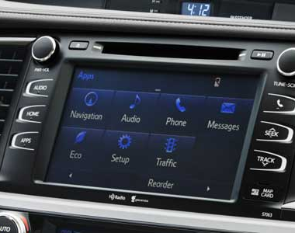
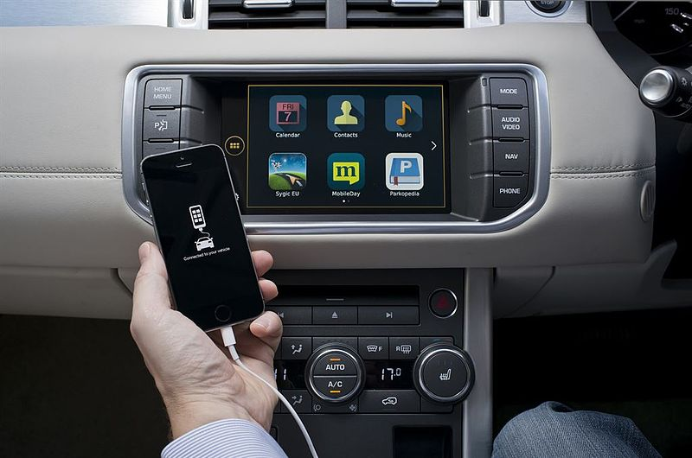
Proposed Methodology
According to the research this concept is entirely new and yet to be implemented.
“The proposed project is the simulation to the real time product.”
The proposed project facilitates with following-
- Remote Car Control
- Location Sharing
- Vehicle Diagnostics
Fig- Infotainment System in cars handled using android

Slide 12
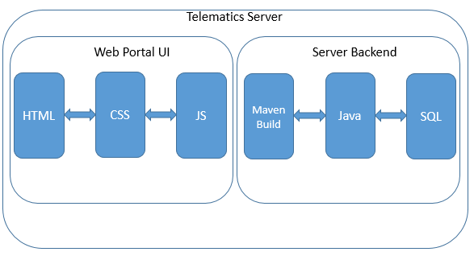
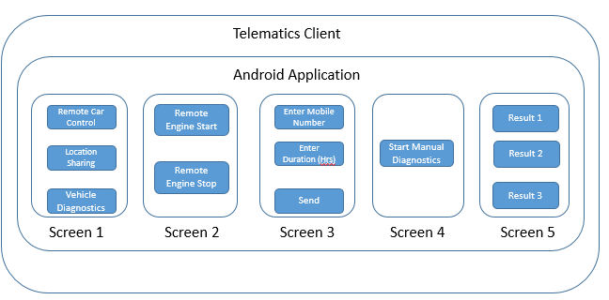
Proposed Methodology

Slide 13
Advantages
Improves Speed of Communication between vehicles.
Secure Communication
New Innovation in Automobile Industry
A step towards better future

Slide 14
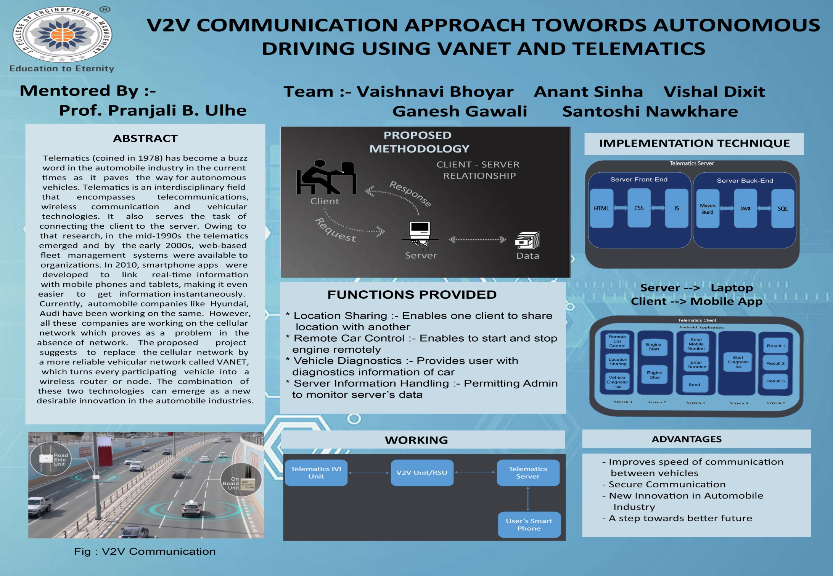

Slide 15
References
Shouyang Wei, Yuan Zou, Senior Member, IEEE, Xudong Zhang, Tao Zhang, and Xiaoliang Li ,
“ An Integrated Longitudinal and Lateral Vehicle Following Control System with Radar and Vehicle-to-Vehicle Communication “ , IEEE 0018-9545 (c) 2018.
Michal Taraba, Juraj Adamec, Matus Danko, Peter Drgona , “ Utilization of modern sensors in autonomous vehicles “, IEEE 978-1-5386-4759-2/18 , 2018.
T.Banerjee1, S.Bose2, A.Chakraborty3 , T.Samadder4 , “ Self Driving Cars: A Peep into the Future “ IEEE 2017
Feng Lv1, Hongzi Zhu1, Shan Chang2, Mianxiong Dong3 , “Synthesizing Vehicle-to-Vehicle Communication Trace for VANET Research “ , IEEE 2017
Youngho Park∗ , Chul Sur† , Si-Wan Noh‡ , and Kyung-Hyune Rhee ∗ , ” Secure Vehicle Location-Sharing for Trajectory-Based Message Delivery on VANETs ” , IEEE 2017

Slide 16
References
Giuseppe Lugano ERAdiate team , “Virtual Assistants and Self-Driving Cars:- To what extent is Artificial Intelligence needed in Next-Generation Autonomous Vehicles?” , IEEE 2017
Alan M. Barker, Gary J. Capps, Mary Beth Lascurain , “Embedded Systems for Intelligent Vehicle Research A Case Study of Hardware-In-the-Loop Data bus Testing Techniques “ , ACM 2016
Dhivyasri G , Rajeswari Mariappan , “Advanced Fuel Level Tracking System Using Telematic Unit “ IEEE 2015
Keshav Bimbraw , “ Autonomous Cars: Past, Present and Future A Review of the Developments in the Last Century, the Present Scenario and the Expected Future of Autonomous Vehicle Technology “ , ACM , 2014

Slide 17
References
https://www.instructables.com/id/Set-up-your-very-own-Web-server/
https://www.godaddy.com/garage/how-to-make-a-minecraft-server/
https://www.youtube.com/watch?v=gzZ-bb11Q_s
https://developer.android.com/training/basics/firstapp/creating-project
https://abhiandroid.com/ui/edittext#Example_I_8211_EditText_in_Android_Studio
https://www.google.com/search?client=firefox-b-d&q=hoew+we+can+use+button+in+andriod#kpvalbx=1
https://www.javatpoint.com/android-working-with-button

Slide 18
Thank You

